Slide 1

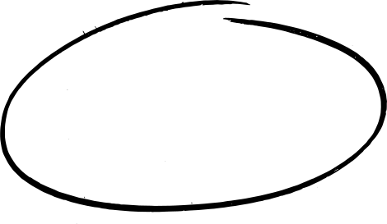


CASE STUDY 1
SOLVING REAL-WORLD PROBLEMS USING COMPUTATIONAL THINKING
Learn how to optimize team tasks

Slide 2

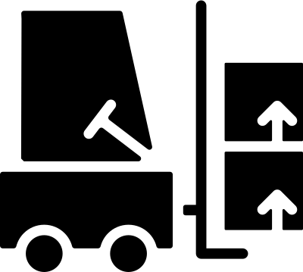
INTRODUCTION TO THE PROBLEM
You’re an appliances supplier and you want to ship the items from your warehouse to give to your distributor and sell it as soon as possible. You have a forklift that can carry two items at a time and has a capacity weight of 2,000kg, you also have a truck that has 10,000kg capacity weight which is the storage of your items picked. You have a warehouse that has six aisles with different items. Your goal is to get the most preferable items in an aisle and putting it to the truck considering how many minutes you consume in the process. (Assuming the minutes are constant and picking time is not considered)
AISLE 3
1 min
AISLE 4
2,000 KG
0.2 min
START
0.1 min
AISLE 1
AISLE 5
10,000 KG
0.5 min
1.5 min
0.3 min
DROP-
OFF
0.1 min
AISLE 2
AISLE 6
3.5 min

Slide 3
NAME | AISLE | WEIGHT | PRICE
SELF-N-FORGET COOKER | 1 | 1458 | 2949
WASHING MACHINE | 3 | 1408 | 2584
THERMAL MASS REFRIGERATOR | 5 | 1313 | 1686
SOUS-VIDE COOKER | 3 | 751 | 2958
ELECTRIC WATER BOILER | 1 | 1302 | 4590
ENERGY REGULATOR | 4 | 646 | 4129
THERMAL IMMERSION CIRCULATOR | 2 | 715 | 3656
AIR CONDITIONER | 6 | 957 | 2389
ENERGY REGULATOR | 1 | 598 | 564
INTERNET REFRIGERATOR | 6 | 1193 | 2361
TURKEY FRYER | 1 | 973 | 4791
BEVERAGE OPENER | 6 | 1002 | 3812
HOME SERVER | 4 | 934 | 4148
CLOTHES DRYER | 2 | 1079 | 2671
VACUUM CLEANER | 5 | 1346 | 864
HUMIDIFIER | 4 | 792 | 2690
PANINI SANDWICH GRILL | 2 | 1241 | 3564
FLATTOP GRILL | 4 | 1352 | 1545
MICROWAVE OVEN | 1 | 616 | 4390
ICEBOX | 3 | 1275 | 2405
 |  | 20951 | 58746

Slide 4
Decomposition
Sub-problems:
Iteration 1
Find the shortest parth/route of the forklift to aisle and back to truck
Maximize the weight capacity of the forklift with preferable items
Capacity of the truck must not exceed to 10,000 KG
Problem Identification
How to put items in the truck that satisfies the maximum weight in maximum price and consider the minutes that you consume in the process?
Pattern Recognition
We can consider that the heavier items have a big price so we can consider on taking it first.
Abstraction
Relevant Information: Weight capacity and time
Irrelevant Information: Appliance supplier, distributors

Slide 5
Decomposition
Iteration 2
SUB-PROBLEM:
- Conceptualize the graph of each aisle
Problem Identification
I want to find the shortest possible route of the forklift to the aisle and back to the truck which algorithm is best fit to make this work?
Pattern Recognition
THERE ARE THREE WAYS THAT THE FORKLIFT CAN TRAVEL FROM START TO DROP OFF CONSIDERING THE MINUTES IT WILL TAKE ON EACH AISLE.
Abstraction
RELEVANT INFORMATION: NODES AND EDGES OF EACH AISLE
Irrelevant Information: Items that are not included in the knapsack

Slide 6
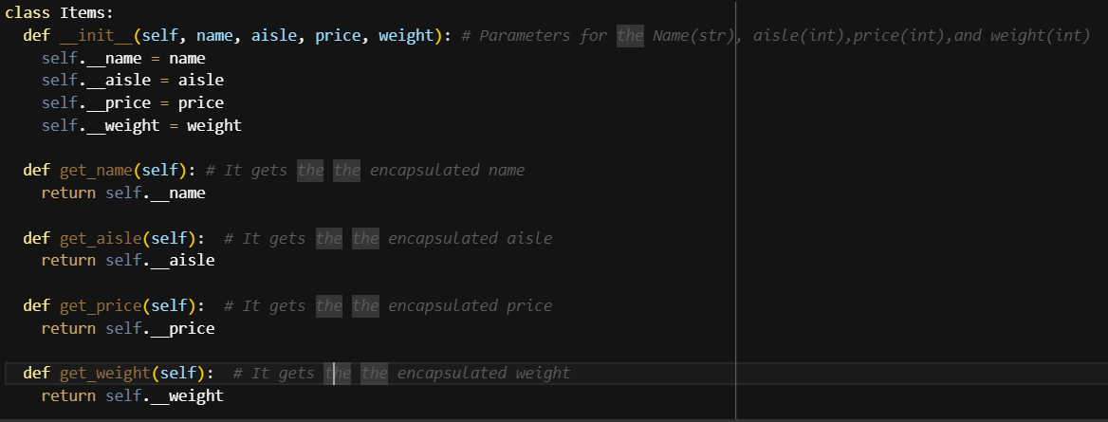
IMPLEMENTATION OF CODE
First thing we do is make a class for the Items

Slide 7
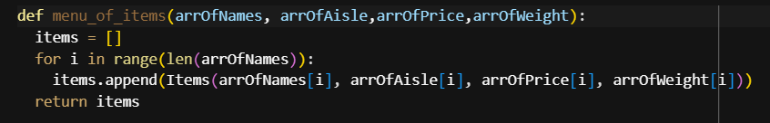
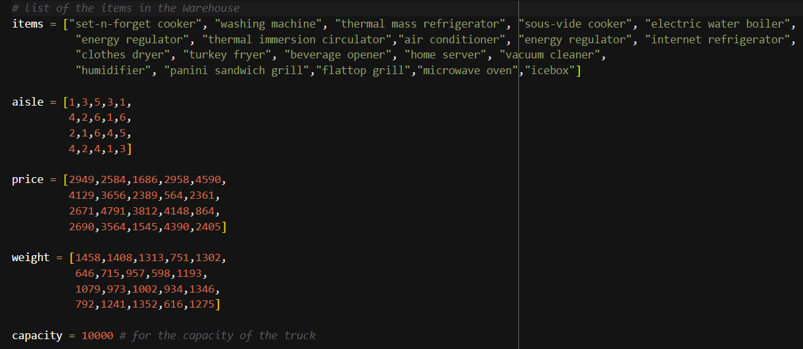
Then, we created a function for menu list so that it is organized, and then proceed to create an array per category, by using the class and the function the values are stored efficiently.

Slide 8
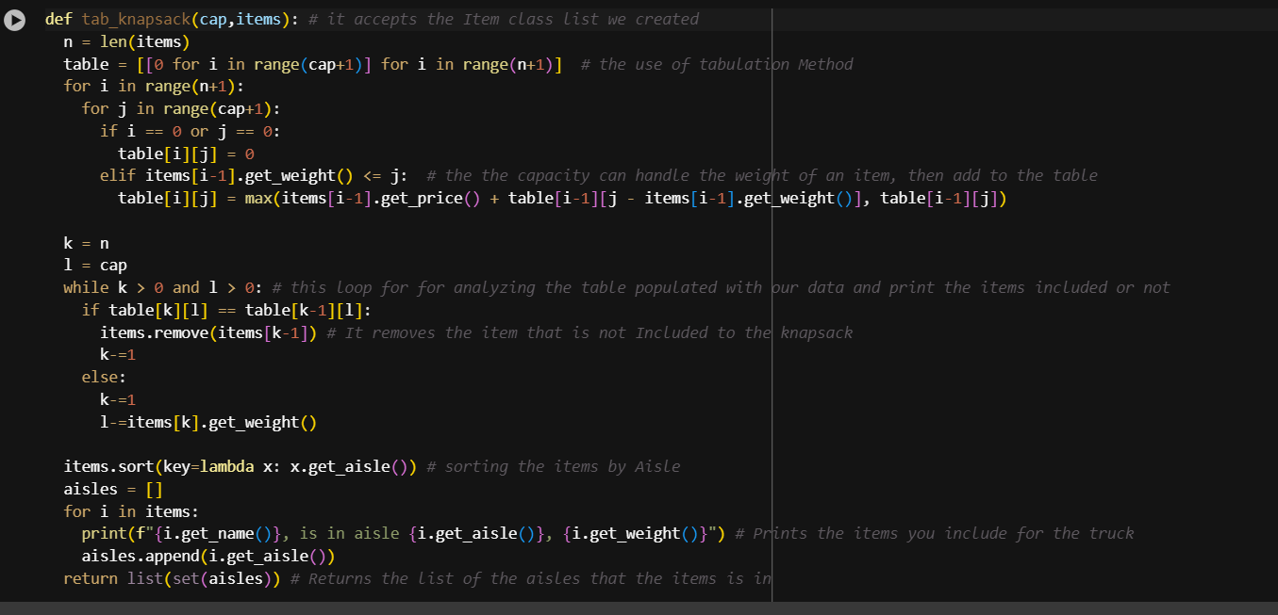
Next, we will now create the knapsack function for the data and the truck, this also stores the aisle of the items to be picked

Slide 9
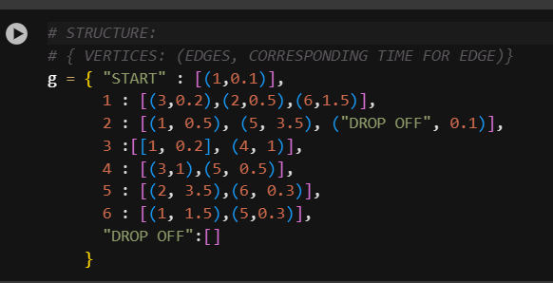
This part of the code will feed the items_menu in to the knapsack
Now let’s proceed to the making of the graph. We decided to take a simple route in making the graph, we create a dictionary to represent the graph and corresponding time in connecting edges.

Slide 10
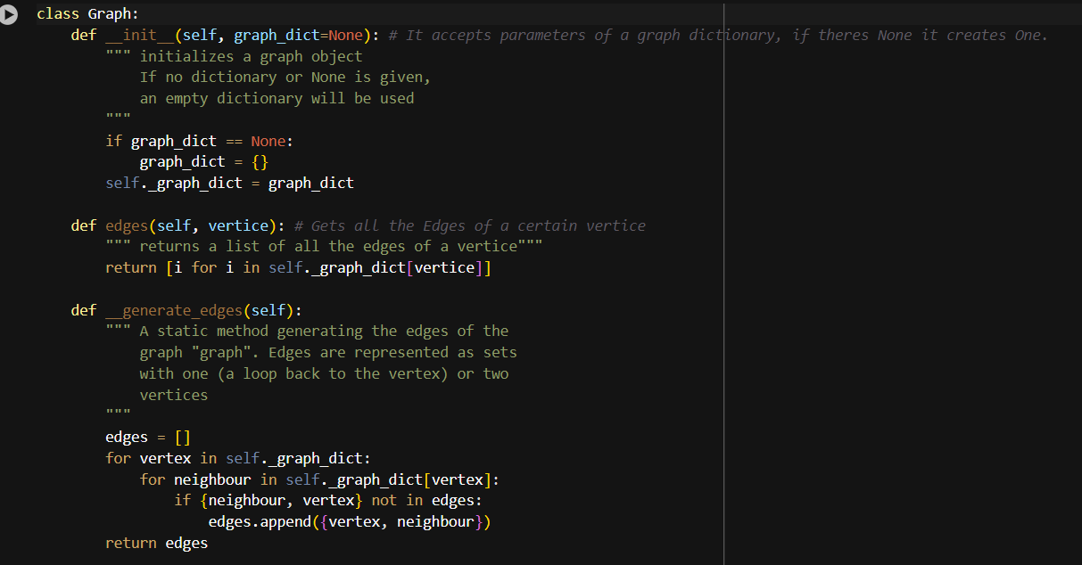

Slide 11
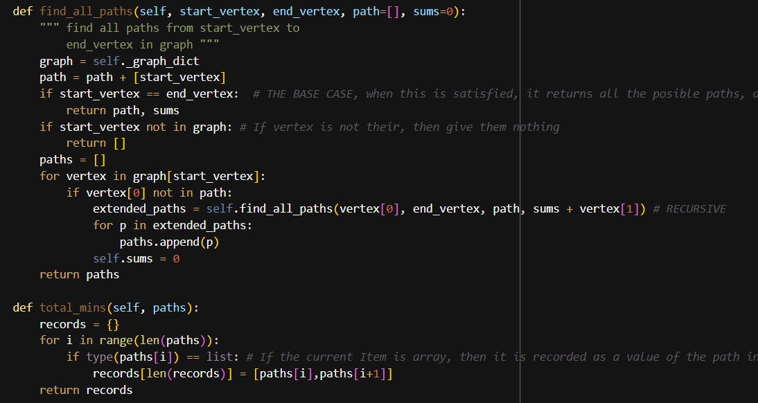

Slide 12
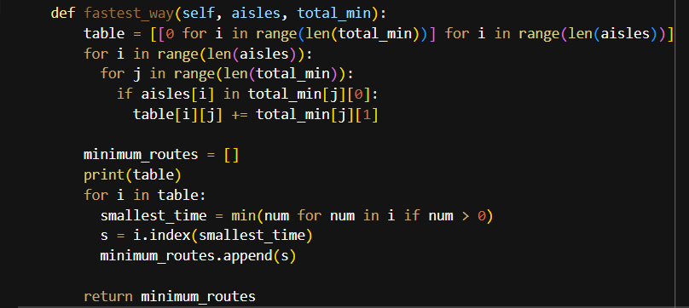

Slide 13
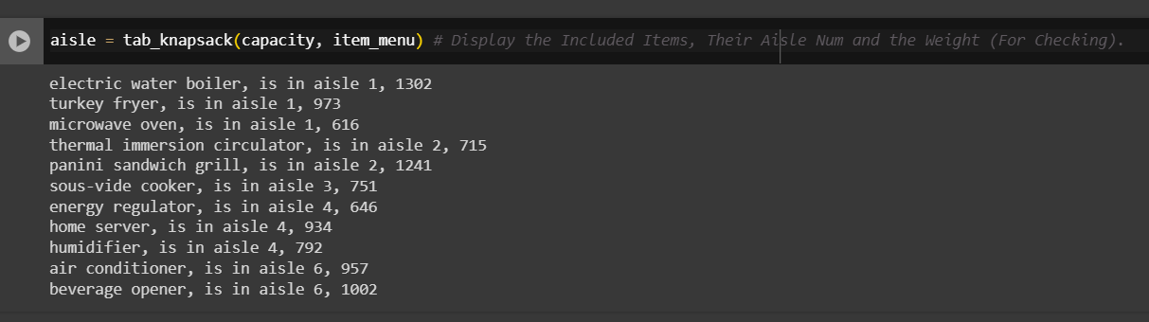

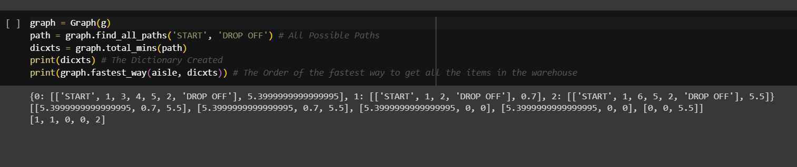
RESULTS

